Slide 1
Employee Data Analysis using Excel
STUDENT NAME: Anchal. S
REGISTER NO:312217102
DEPARTMENT:B.Com (general)
COLLEGE : Shri Krishnaswamy college for women

Slide 2
PROJECT TITLE
Creating and employe performance scorecard in excel

Slide 3


AGENDA
Problem Statement
Project Overview
End Users
Our Solution and Proposition
Dataset Description
Modelling Approach
Results and Discussion
Conclusion
3/21/2024 Annual Review

Slide 4

PROBLEM STATEMENT
To create an employee performance scorecard in Excel, you need to design a tool that evaluates and tracks employees' performance based on predefined criteria. The scorecard should include key performance indicators (KPIs), goals, and assessment metrics.

Slide 5

PROJECT OVERVIEW
.
The project involves developing an employee performance scorecard in Excel to systematically assess and track employee performance. The scorecard will include criteria such as job-specific skills, goals, and key performance indicators (KPIs).

Slide 6

WHO ARE THE END USERS?
The end users of an employee performance scorecard in Excel are typically HR managers, team leaders, and supervisors who need to assess, track, and manage employee performance.

Slide 7

OUR SOLUTION AND ITS VALUE PROPOSITION
**Solution:Create a customizable Excel-based employee performance scorecard that tracks key performance indicators, goals, and achievements. **Value Proposition: This solution provides a cost-effective, user-friendly tool for evaluating employee performance.

Slide 8
Dataset Description
The dataset for an employee performance scorecard typically includes: 1. **Employee Information:Name, ID, department, and role. 2. **Performance Criteria: Key performance indicators (KPIs), goals, and job-specific skills. 3. Assessment Data:Ratings or scores for each KPI, goal achievement percentages, and qualitative feedback.

Slide 9

THE "WOW" IN OUR SOLUTION
The "wow" factor in our Excel-based employee performance scorecard solution lies in its ability to deliver a highly customizable, easy-to-use tool that automates performance tracking and reporting. It integrates real-time data updates and visual analytics, providing clear insights into employee performance and facilitating more informed and efficient performance reviews.
3/21/2024 Annual Review
9

Slide 10
MODELLING
Modeling an employee performance scorecard in Excel involves: 1. **Define Criteria:Identify key performance indicators (KPIs), goals, and competencies relevant to the role. 2. **Design Layout:Create a structured layout with sections for employee details, performance metrics, and scoring. 3. **Input Data:Set up cells for data entry, including performance ratings and comments.
10

Slide 11
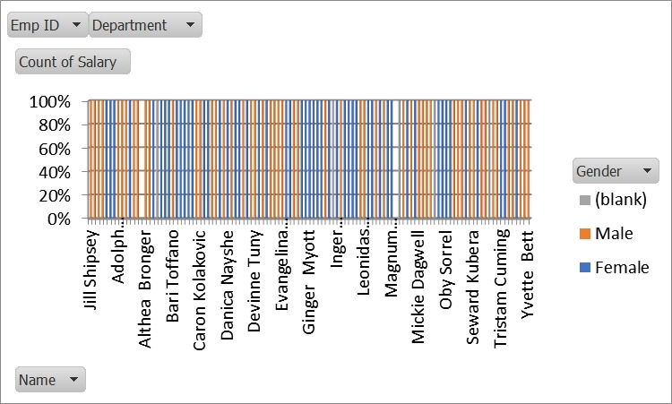
RESULTS
11

Slide 12
conclusion
Creating an employee performance scorecard in Excel involves setting up a spreadsheet to track and evaluate key performance indicators (KPIs) for employees. Start by identifying relevant KPIs that align with job roles and company goals. Create columns for each KPI, along with criteria for evaluation. Input employee data and set up formulas to calculate scores.

